Slide 1
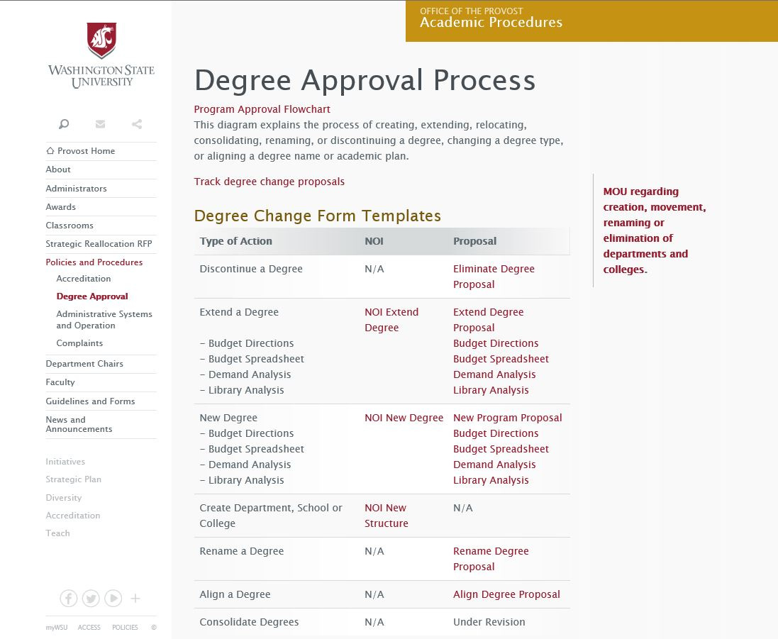
https://provost.wsu.edu/procedures/degree-approval/

Slide 2
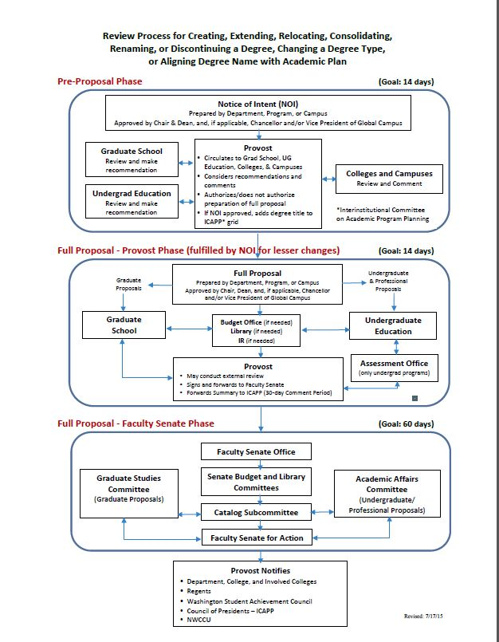
https://provost.wsu.edu/procedures/degree-approval/

Slide 3
Board of Regents and NWCCU Approval
After proposals are approved by the Faculty Senate, they are recommended to the Board of Regents
The Accreditation Liaison Officer requests permission from NWCCU (Northwest Commission on Colleges and Universities)

Slide 4
Bylaws Approval Process
Program submits bylaws draft to Graduate School (carris@wsu.edu) for review/input
Revised bylaws sent to Graduate Studies Committee for review and approval
Approved bylaws/GSC approval memo sent to Faculty Senate as Information Item; Approved bylaws maintained in Graduate School with GSC approval date

Slide 5
Graduate Faculty Lists—updates & approval
Initial list of graduate faculty established as part of bylaws
Lists of graduate faculty are to be updated on an annual basis—call for updates will be sent after end of Spring Semester
Updated lists checked using program bylaws and DEPPS
Approved lists available at https://gradschool.wsu.edu/master-faculty-list/

Slide 6
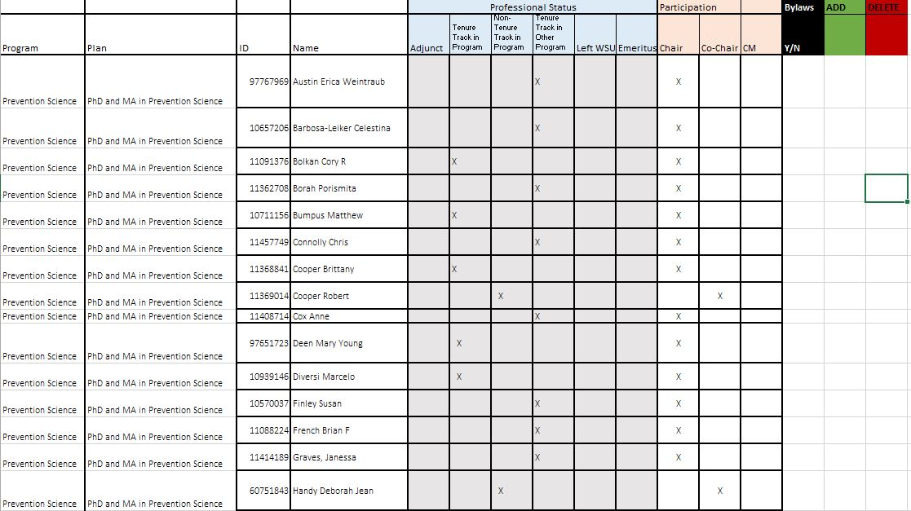
Example of template for graduate faculty lists

